Slide 1

Team Name :
Team Details:
TEAM: TECHSIRENS
“GLOBAL FASHION COLLABORATION ON MYNTRA”
TechSirens
Khushboo Kumari : khushboo53903@gmail.com
Insha Naseem: insharham@gmail.com

Slide 2

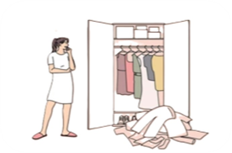


Problem Statement:“Engagement on a shopping platform”
Current Challenges:
•Access to Global Talent:Providing global designers a platform to showcase their creations and gain exposure in the competitive fashion industry, overcoming connectivity challenges.
•Limited Design Variety: Addressing the challenge of offering diverse, trendy, and unique clothing designs to cater to Myntra's Gen-Z customer base.
•Market Relevance and Freshness: Ensuring Myntra's competitiveness by continually introducing fashionable designs aligned with current trends, attracting and retaining a fashion-savvy audience.
•Engagement and Retention: Enhancing user engagement and retention through compelling content and interactive experiences to foster habitual use of the Myntra platform.

Slide 3



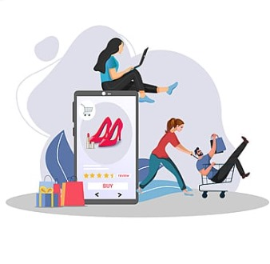
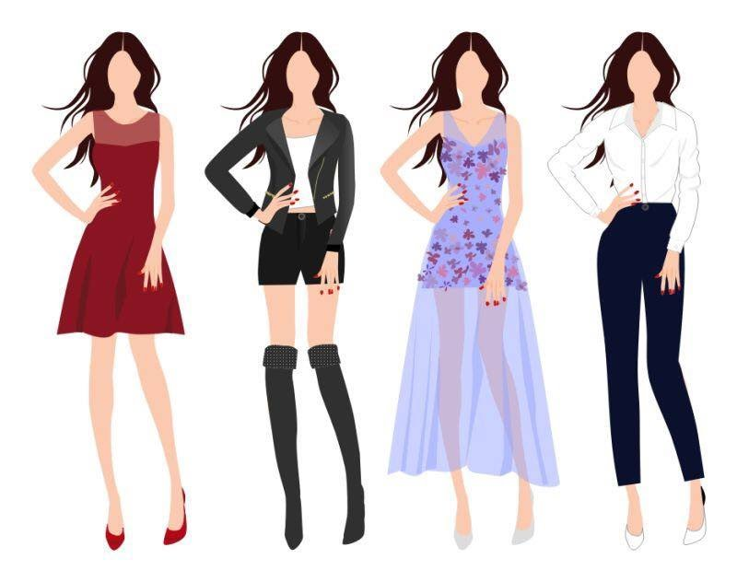
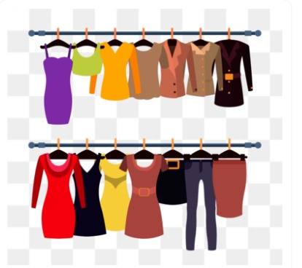
Proposed Solution: Global Designer Collaboration
Design Selection by a Panel of Fashion Experts and Myntra Representatives
Designers / New Brands Receiving Offers to Sell Their Creations to Myntra
Designers Submitting Their Clothing Designs on the Myntra Portal
Result: Enhanced Platform Engagement with Trendy Outfits
Myntra Acquiring Numerous New Designs Aligned with Gen-Z Trends
Host Virtual Fashion Shows, Live Q&As, and Interactive Workshops to Boost Engagement

Slide 4



Feasibility Of Implementing the solution
1.Technological Infrastructure
Platform Enhancement: Upgrades to UI and backend systems for new features and functionalities.
Data Management: Advanced analytics tools for seamless customer experiences.
2. Resource Allocation Designers Onboarding
Designers Onboarding: Dedicated team for quality standards and guidelines.
Marketing and Promotion: Resources allocated for new collections and platform traffic.
3. Operational Considerations
Supply Chain Integration: Streamlining processes for efficient inventory and order management.
Customer Support: Enhanced customer support for new collections.
4. Financial Viability
Initial Investment:Initial investment justified by increased revenue potential.
Expected Impact:Expected higher sales and customer engagement for favorable returns.
5. Market Readiness
Consumer Demand: Growing interest in unique fashion items supports new designer introductions.
Competitive Advantage: Differentiates Myntra, enhancing leadership in fashion e-commerce.

Slide 5

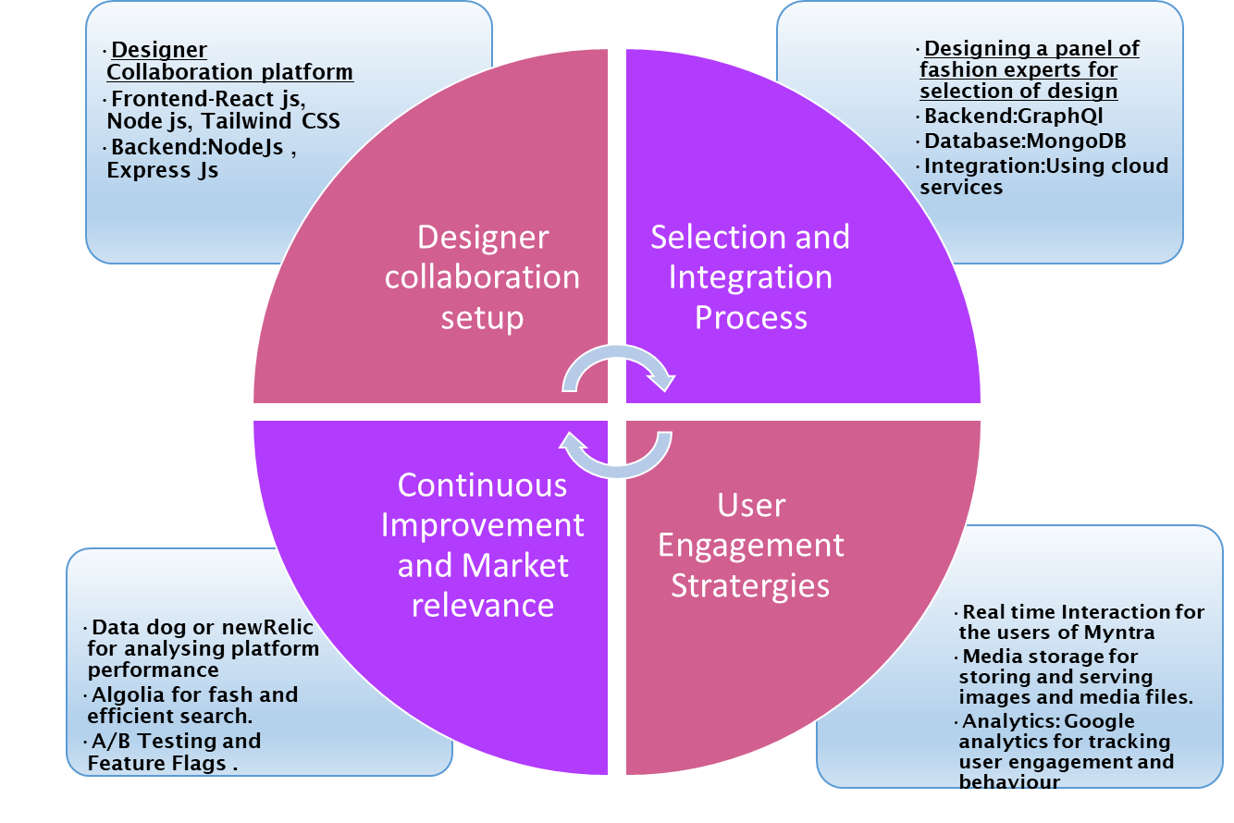



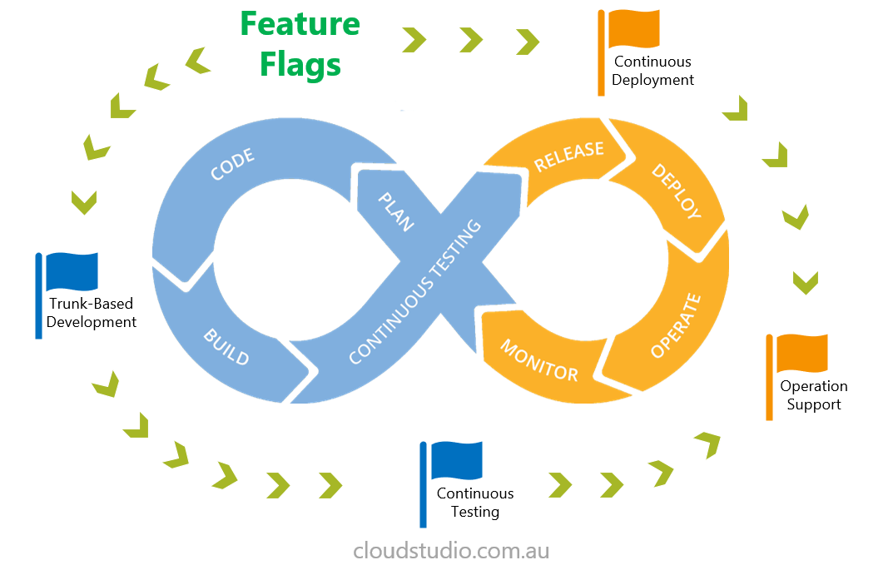
TechStacks
2
.
1
4
3

Slide 6


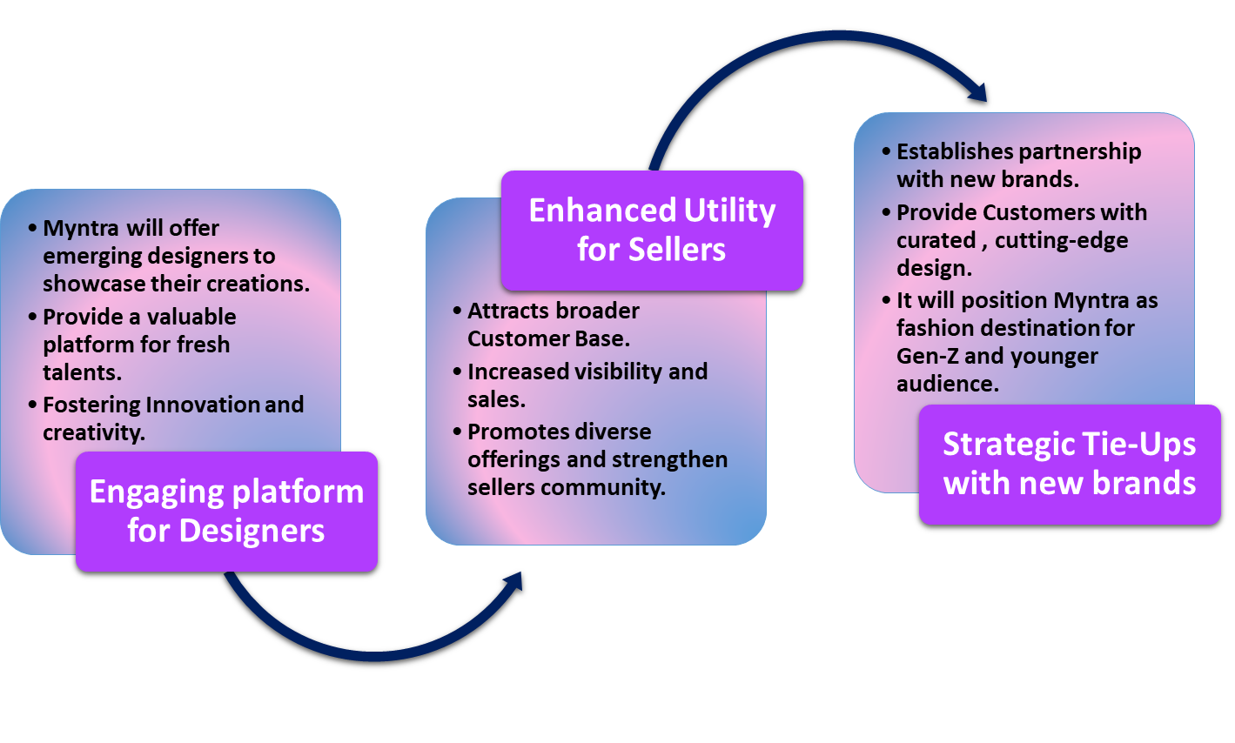
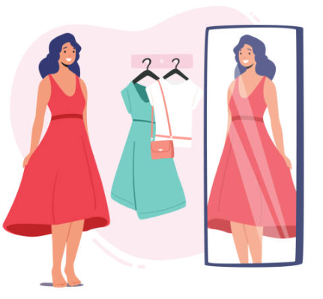

Benefits of Implementing Solutions:

